Slide 1
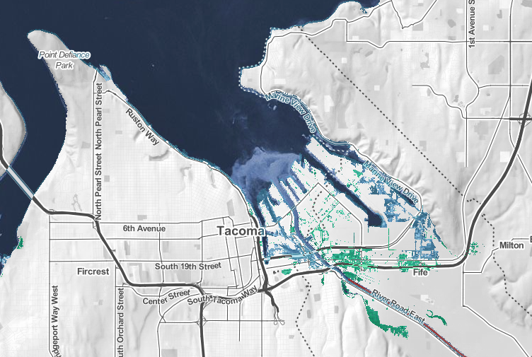
Sea Level Rise Impacts in Tacoma

Slide 2
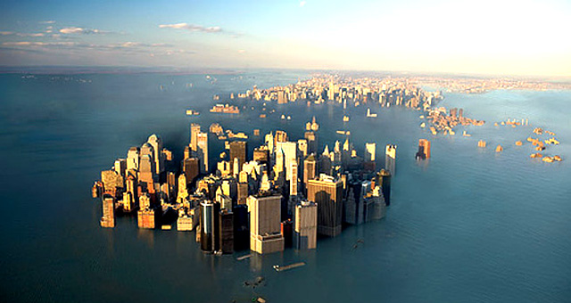
Sea Level Rise Scenarios for Decision-Making
Global Sea Level Rise (SLR) is estimated to range from 0.2 to 2+ meters by 2100
Given this uncertainty, decision-makers can use a scenario approach to model various outcomes given different levels of SLR.
“Scenarios are used to develop and test decisions under a variety of plausible futures. This approach strengthens an organization’s ability to recognize, adapt to, and take advantage of changes over time” (Parris et al., 2012).
Notes:
Global SLR is estimated to range from 0.2 to 2 meters by 2100, depending on changes in the Polar Regions and other ecological impacts that may expedite climate change (positive feedback cycles, tipping points, ocean acidification, etc.)
To address this uncertainty in planning, a scenario approach can be used to aid policy-makers when planning how to best adapt and prepare for future sea level rise.

Slide 3
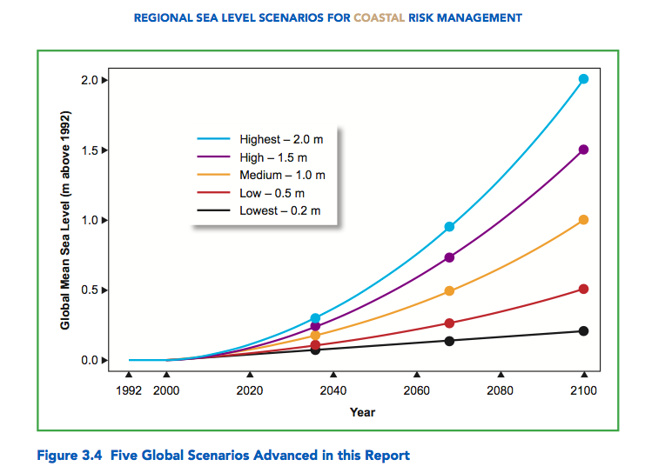

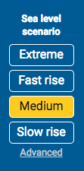
Sea Level Rise Scenarios
???
Highest (2.0 m)
→ Medium (1.0 m)
→ Lowest (0.2m)
What is the Extreme scenario?
Notes:
The 4 sea level rise scenarios and projections on Risk Finder are based on a Department of Defense report by Hall et al. 2016 (citation below), illustrated in the graph.
Recent studies have modeled a possible “extreme” scenario that would occur if some parts of the Antarctic Ice sheet begin to collapse sooner than expected by scientists. This is a low probability outcome, but would result in catastrophic damages to coastal cities around the globe.
Hall, J.A., S. Gill, J. Obeysekera, W. Sweet, K. Knuuti, and J. Marburger. 2016. Regional Sea Level Scenarios for Coastal Risk Management: Managing the Uncertainty of Future Sea Level Change and Extreme Water Levels for Department of Defense Coastal Sites Worldwide. U.S. Department of Defense, Strategic Environmental Research and Development Program. 224 pp.

Slide 4
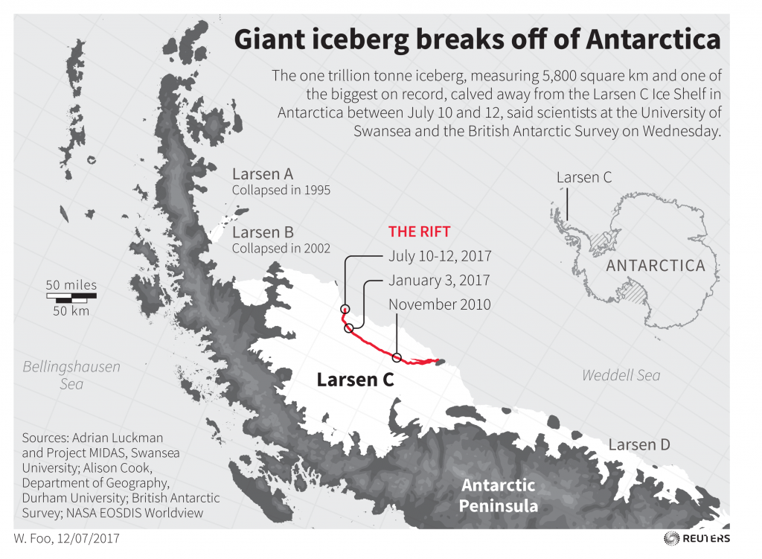
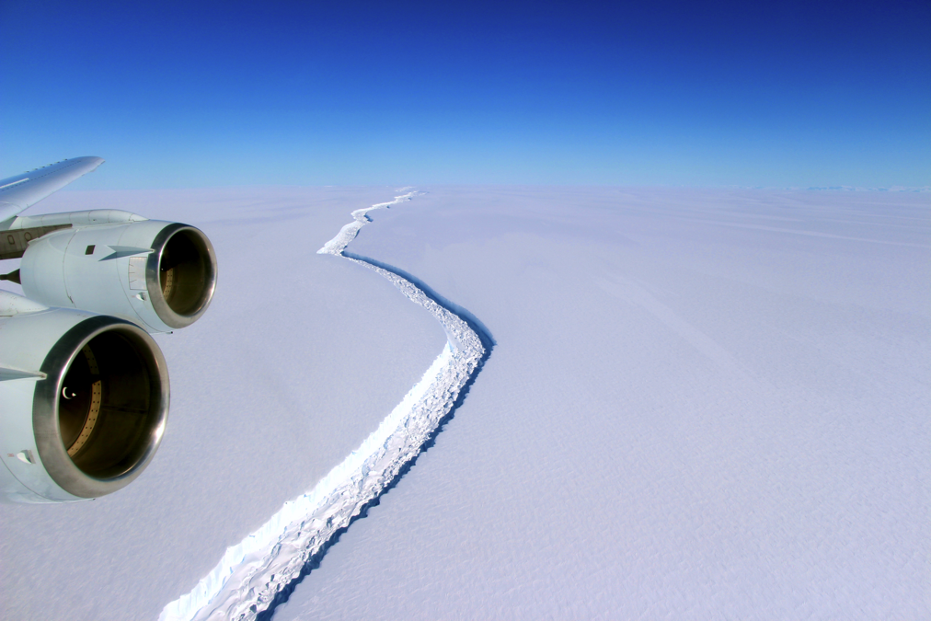
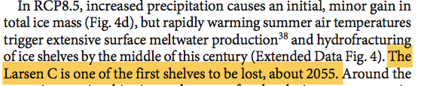
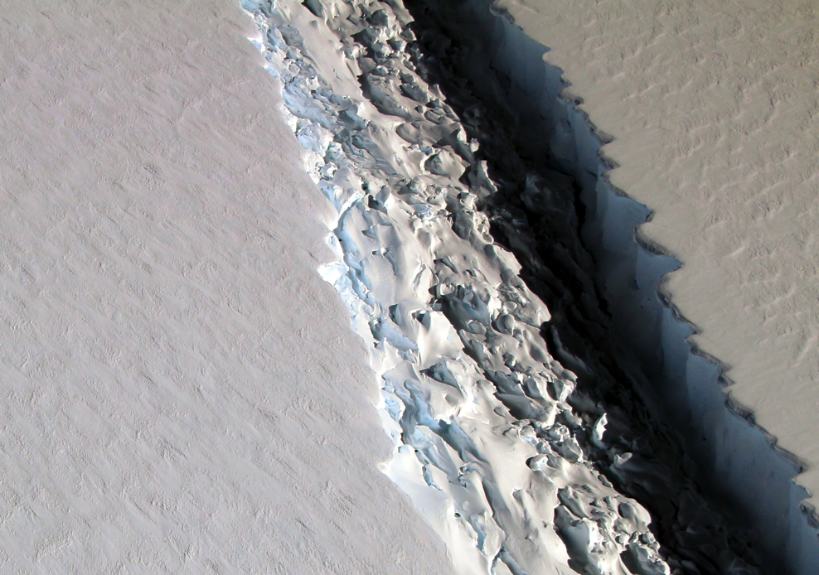
- DeConto and Pollard 2016, Nature
Notes:
Click the main graphic the watch a video from the Guardian on the Larsen C ice shelf breaking off (1:34 minutes)
video.nationalgeographic.com/video/magazine/170622-ngm-antarctica-melting-sea-levels-climate-change
Another good video: PBS News Hour video on Antarctica: https://www.youtube.com/watch?v=4R2hlWAsbQ0

Slide 5
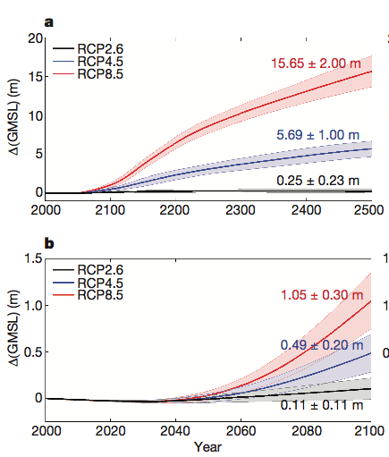
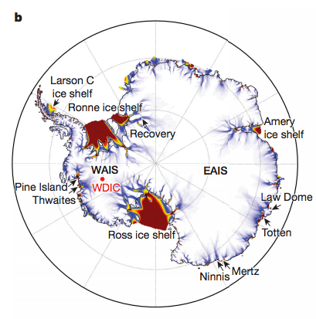
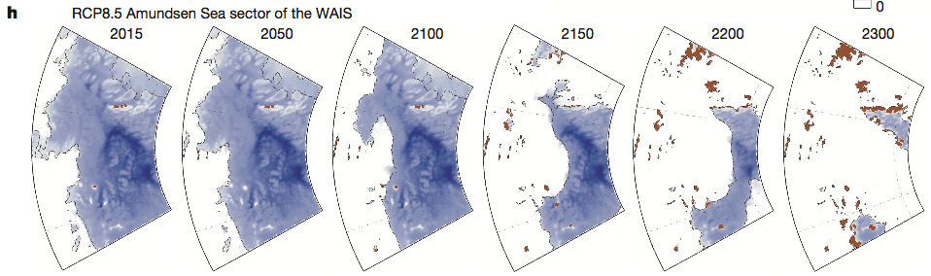
Future Antarctic Contributions to Sea Level Rise
Representative Concentration Pathways (RCP)
RCP8.5 – fossil fuel intensive high emissions scenario or business as usual
RCP4.5 - moderate emissions stabilizing by 2050 then declining
RCP2.6 – drastically cut back on CO2 emissions taking immediate actions
Amundsen Sea
Notes:
Extreme scenario → 3m or 8+ feet of SLR by 2100 and more than 15 meters or more than 50 feet by 2500.
From Pause for Analysis question – what do you think is driving the different scenarios?
Different CO2 emissions trajectories.
Source: Deconto and Pollard 2016 Nature
Figure 5 | Large Ensemble model analyses of future Antarctic contributions to GMSL. a, RCP ensembles to 2500. b, RCP ensembles to 2100. Changes in GMSL are shown relative to 2000, although the simulations begin in 1950. Ensemble members use combinations of model parameters (Methods) filtered according to their ability to satisfy two geologic criteria: a Pliocene target of 10–20 m GMSL and a LIG target of 3.6–7.4 m.

Slide 6
Sea Level Rise Scenarios
Extreme (3 m)
Highest (2.0 m)
→ Medium (1.0 m)
→ Lowest (0.2m)
Notes:
The Extreme Scenario would occur if land ice in the Antarctic melts faster than anticipated given scientific models. DeConto and Pollard and others have modeled this possibility which motivated the addition of this Extreme scenario to the risk finder website (also see NOAA Technical report for more information on the scenarios used on the Riskfinder.org website).
Extreme Sea Level Rise Scenario – take the High Scenario and add 1 meters under the BAU emissions scenario (RCP8.5)

Slide 7
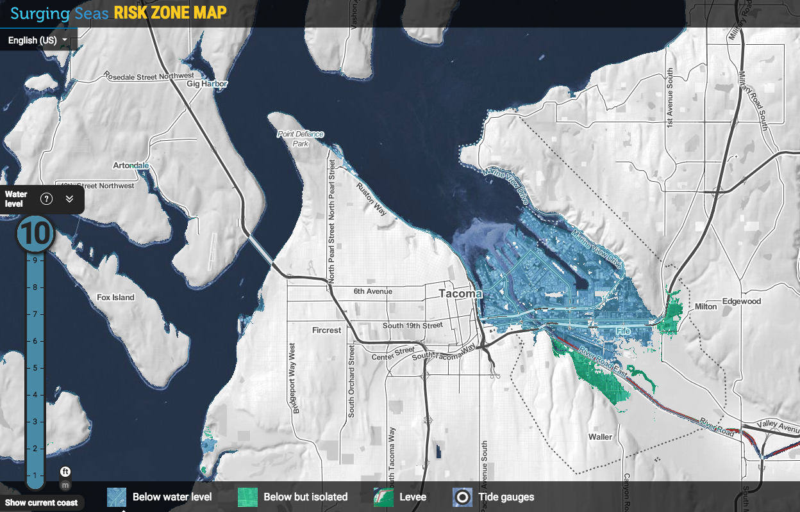
Notes:
Tacoma under the extreme sea level rise scenario 10 feet of SLR

Slide 8
Part II. Tools for Analysis: What are the expected damage costs of flooding?
Expected Value Analysis
, or
We can use expected value analysis to incorporate risk into our decision-making by multiplying the damage costs of a flood event (x_{j}) by the probability of the flood occurring, p(x_{j}) for ‘n’ potential outcomes.
In this case, n=2, Flood or No Flood
Notes:
Excerpt taken from Gibbs 1994 on using expected value analysis for estimating the economic impacts of flooding. (https://pdfs.semanticscholar.org/6d0a/03531c5a5106220873dcbe59c567c78935ec.pdf) Chapter 7, page 5.
‘’The total expected damage is computed by multiplying the damage from each storm type (e.g., a 100-year storm) times the probability of the storm occurring in any given year. The expected value of damages is analogous to an actuarially fair premium for insurance that would cover 100 percent of flood losses.
This quantity reflects the true cost of the risk of storm damages on an annual basis. Of course, in any given year, a damaging storm may or may not occur. Consequently, the actual storm damages in any given year will rarely equal the expected value of storm damages. However, over a long period of time, the total damage experienced would approach the total expected value of damages, making the expected value an appropriate valuation of flood risk for the purposes of an economic analysis such as this.’’

Slide 9
Part II. Tools for Analysis: What are the expected damage costs of flooding?
Calculating expected damages from SLR and flooding in Tacoma
E[x_{i} ] = x_{F,i}*p_{F,i} + x_{NF,i}*p_{NF,i}
E[X_{i}] is the expected damage from a maximum flood height of i, for i=1, 2, …10
For each flood level, i, there is probability p_{F,i} of Flooding which would cause x_{F,i} dollars in property damages.
What is the value of the second term, x_{NF,i}*p_{NF,i}? Why?
p_{NF,i} is the probability of No Flood in which case damages would be 0, or x_{NF,i} = 0
Thus, our calculation simplifies to: E[x_{i} ] = x_{F,i}*p_{F,i} for i= 1, 2, …10

Slide 10
Part II. Tools for Analysis: Marginal Damage Curves
Example: Marginal Damages of Pollution
CO₂ Marginal Damage Curve
As CO₂ emissions increase, the damage cost from each additional ton of pollution is more than the previous ton.
$
What area on the graph represents the
Total Damage Costs from Q₂ tons of CO₂?
Why do you think the marginal damages
increase as CO₂ emissions increase?
150
100
0
Q₁
Q₂
Tons CO₂
Notes:
Explain the difference between marginal damage cost and total damage cost at different quantities of Q
Discussion Questions:
What area on the graph represents the Total Damage Costs from Q₂ tons?
Total damages of some Q are represented by the area under the marginal damage curve at that Q.
Why do you think the marginal damages increase as CO2 emissions increase?
At low levels of pollution, the damages are small since the atmosphere has the capacity to absorb the CO2. But as emissions increase the absorptive capacity of the atmosphere and earth’s systems (e.g. trees, ocean, soil, etc.) is maximized so the damages associated from higher CO2 concentrations in the atmosphere increase at an increasing rate, such as more extreme storm events, droughts, or floods, that are increasingly likely at higher and higher concentration levels. At really high emissions levels tipping points might be reached which could result in catastrophic events such as extreme ice melt in Greenland and sea level rise of 20+ feet.

Slide 11
Part IV. Tools for Analysis: How much to spend on adaptation to Sea Level Rise?
Principle of Marginal Analysis
The optimal quantity, Q* , is where the Marginal Benefit = Marginal Cost
Why would Q’ not be optimal? Q’’?
The Total Cost of Q* is the area under the Marginal Cost curve from 0 to Q*
What area represents the Total Value of Benefits at Q*?
How could this principle apply to decisions on sea level rise adaptation in Tacoma?
What are the costs and benefits?
$
Marginal
Cost
Marginal
Benefit
0
Q’
Q*
Q’’
Q Quantity
Notes:
Spend to the point where the Marginal Benefit of an additional dollar equals the Marginal Cost of that dollar
At Q’ the marginal benefit of one more unit of Q is greater than the marginal cost of one more unit, so we should have more Q.
At Q’’, the marginal cost is greater than the marginal benefit received, so we should have less Q.
How could this be applied to SLR in Tacoma?
Benefits – avoided damages from flooding
Costs – material and labor costs of building flood protection (e.g. sea walls)
The city should spend money on flood protection only up to the point where the cost of one more dollar of protection is equal to the benefit of that protection in avoided damages.

